Slide 1
Basic object-oriented programming in C++
ThanhNT

Slide 2
Goals
Understand basic concept of object oriented programing (OOP) .
Understand some basic implementation of OOP in c++.
Notes:
And DD tu them

Slide 3
Contents
Introduction to object oriented programming(OOP).
Basic implementation of OOP in C++
Classes
Access specifiers
Access function and encapsulation
Constructors/Destructors
Static members
Friend function and class
Composition/Aggregation/Container class

Slide 4
Introduction to object oriented programming(OOP)
Notes:
*

Slide 5
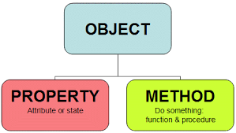
Introduction to OOP
What is OOP?
Programming paradigm based on the concept of classes and objects.

Slide 6
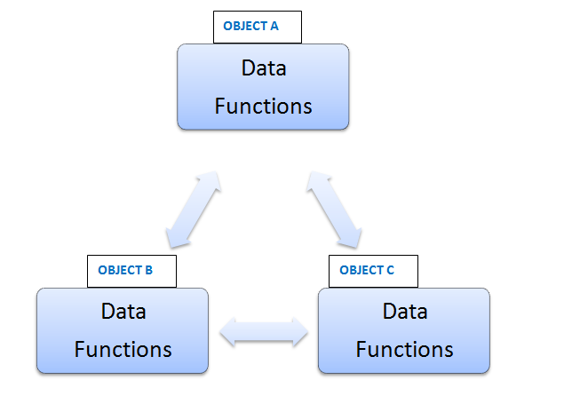
Introduction to OOP
Object oriented programs
Consist of group of cooperating object.
Object exchange messages to achieve common objective

Slide 7
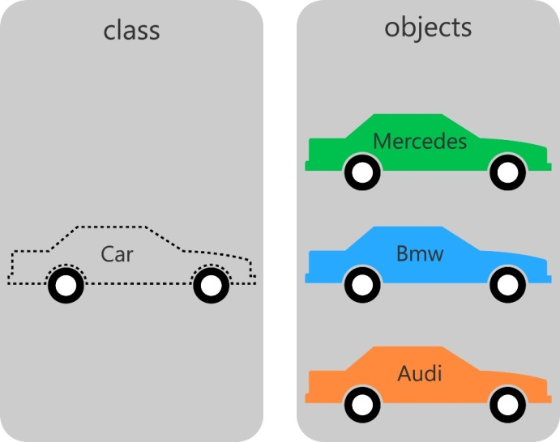
Introduction to OOP
Object and class
Object is an instance of a class

Slide 8
Introduction to OOP
4 major principles of OOP:
Encapsulation
Data abstraction
Inheritance
Polymorphism

Slide 9
Basic implementation of object oriented programming in c+

Slide 10
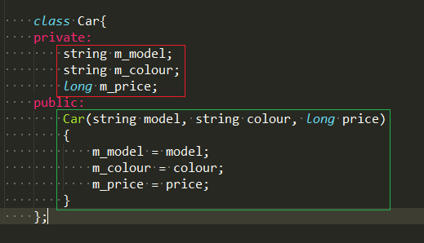
Class and class member
Class
Start with keyword class
Consist of data representation(data member) and methods for manipulating that data (member function).
Notes:
specify the form of an object
combines data representation and methods for manipulating that data.

Slide 11
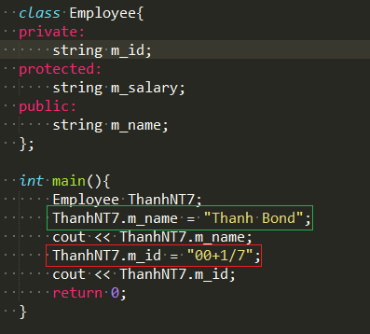
Access specifiers
Private: private member can only be accessed by other members of the class.
Public: public member can be accessed from outside of the class.
Protected: same as private member, but can be inherited.
Notes:
Note: by default, members are set as private.
Line in the red box causes error since m_id is a private member. It can not be modified outside the class scope.
Line in the red box works because m_name is a public member.
Member variables should be kept private

Slide 12
Encapsulation
What?
is the process of keeping the details about how an object is implemented hidden away from users of the object.
How?
is implemented via access specifiers.
Why?
easier to use and reduce the complexity.
help protect your data and prevent misuse.
easier to change and debug.

Slide 13
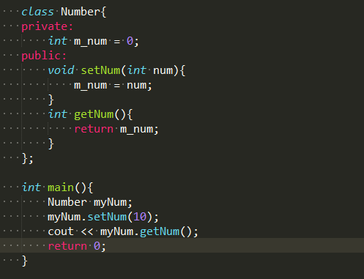
Access function
is a short public function whose job is to retrieve or change the value of a private member variable.
typically come in two flavors: getters and setters.
Getter: return the value of a private member variable.
Setter: set the value of a private member variable.
Notes:
setNum(int) is a setter function while getNum() is a getter function.

Slide 14
Constructors
is a special kind of class member function that is automatically called when an object of that class is instantiated.
typically used to initialize member variables of the class or do any setup steps necessary for the class to be used.
specific rules for constructors:
always have the same name as the class.
have no return type (not even void).
can not be explicitly called.

Slide 15
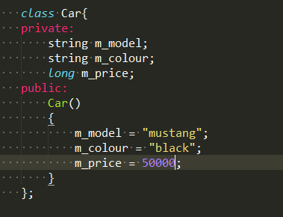
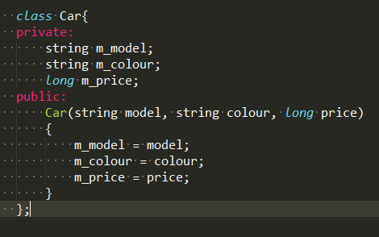
Constructors
Constructor without parameter(default constructor)
Constructor with parameter
Notes:
A constructor that takes no parameters (or has parameters that all have default values) is called a default constructor. The default constructor is called if no user-provided initialization values are provided.

Slide 16
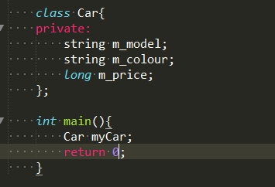
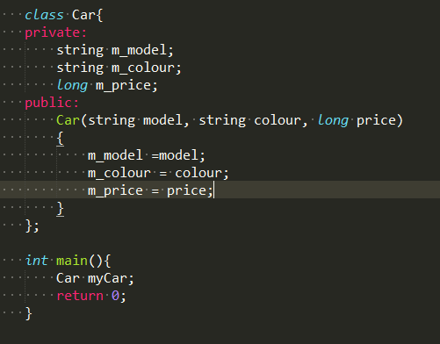
Class without constructors
Notes:
If your class has no other constructors, C++ will automatically create an empty default constructor. Because the empty default constructor does not initialize any of the class’s member variables, if you use it to allocate an object of your class, the member variables of the class will not be initialized and hold garbage values.
if there are other non-default constructors in your class, but no default constructor, C++ will not create an empty default constructor. In this case, the class will not be instantiatable without parameters. Therefore, the declaration Car myCar on the right example will cause error.

Slide 17
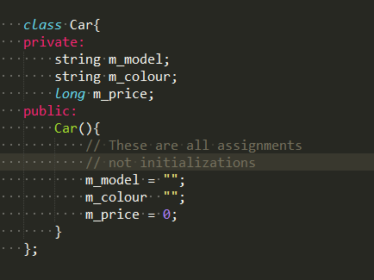
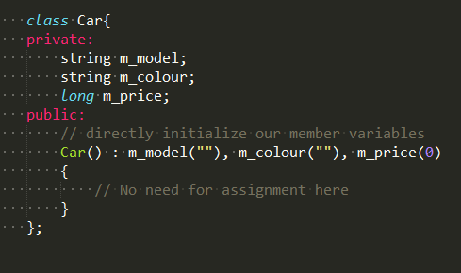
Constructor member initializer list
Notes:
The member initializer list is inserted after the constructor parameters. It begins with a colon (:), and then lists each variable to initialize along with the value for that variable separated by a comma. Note that we no longer need to do the assignments in the constructor body, since the initializer list replaces that functionality. Also note that the initializer list does not end in a semicolon.

Slide 18
Destructors
is a special kind of class member function that is executed when an object of that class is destroyed.
designed to help clean up member variables .
specific rules for destructors:
must have the same name as the class, preceded by a tilde (~).
can not take arguments.
has no return type.

Slide 19
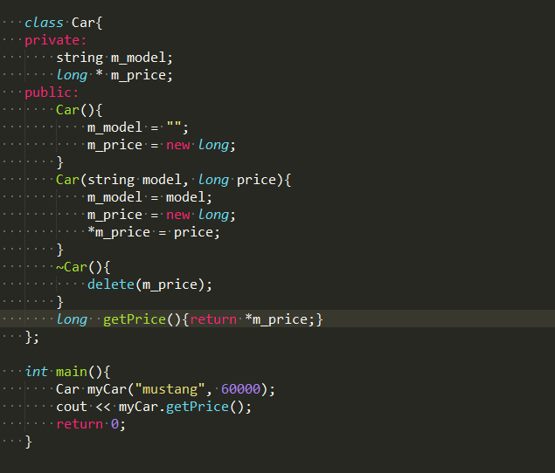
Destructors
Notes:
Destructors are called when the object is destroyed.
Global variables are constructed before main() and destroyed after main().
Note that if you use the exit() function, your program will terminate and no destructors will be called.

Slide 20
Resource Acquisition Is Initialization
What?
is a programming technique whereby resource use is tied to the lifetime of objects with automatic duration.
How?
is implemented via constructors and destructors.
A resource is acquired in the object’s constructor. That resource can then be used while the object is alive.
The resource is released in the destructor, when the object is destroyed.

Slide 21
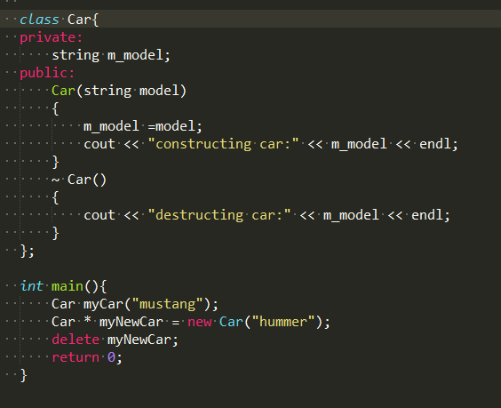
RAII
Why?
The primary advantage of RAII is that it helps prevent resource leaks as all resource-holding objects are cleaned up automatically.
Notes:
Note that myCar is destroyed after myNewCar because we deleted myNewCar before the end of the function, whereas simple was not destroyed until the end of main().

Slide 22
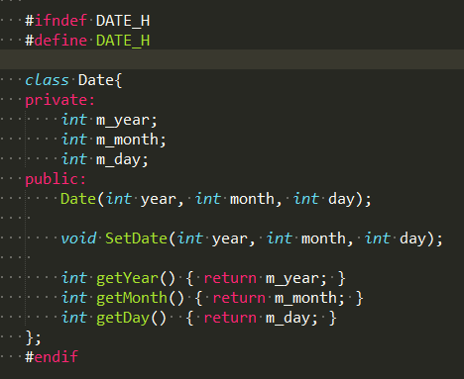
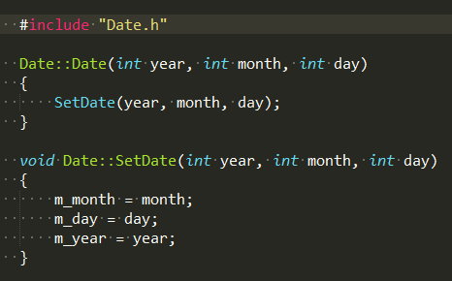
Class code and header files
Date.h
Date.cpp

Slide 23
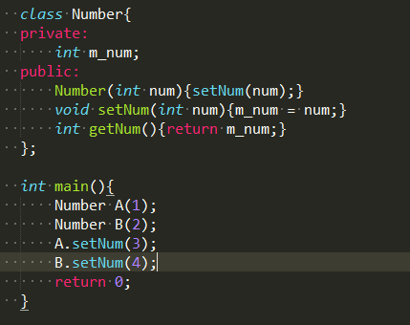

The hidden *this pointer
The function
;when compiled, is actually
converted into

Slide 24
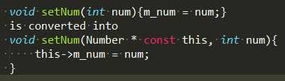

The hidden *this pointer
The this pointer is a hidden const pointer that holds the address of the object the member function was called on.
*this always points to the object being operated on.
Each member function has a *this pointer parameter that is set to the address of the object being operated on.
Notes:
When the compiler compiles a normal member function, it implicitly adds a new parameter to the function named “this”.
Note that the *this pointer alternately holds the address of object A or B depending on whether we’ve called a member function on object A or B.
Because *this is just a function parameter, it doesn’t add any memory usage to your class (just to the member function call, since that parameter goes on the stack while the function is executing).

Slide 25
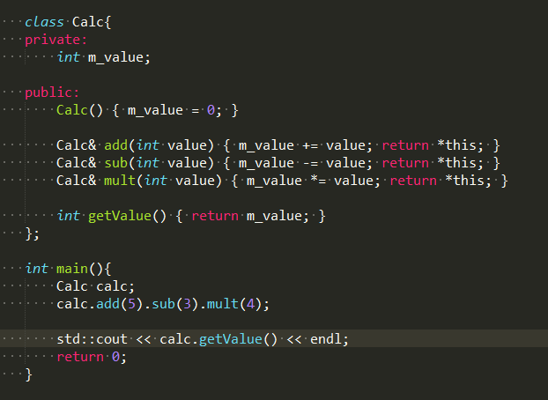
The hidden *this pointer

Slide 26
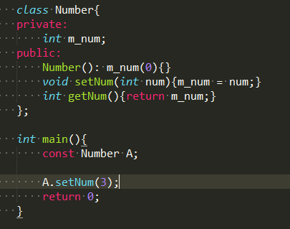
Const class objects
instantiated class objects can also be made const by using the const keyword.
Initialization is done via class constructors.
Once a const class object has been initialized, any attempt to modify the member variables of the object is disallowed.
Notes:
This includes both changing member variables directly (if they are public), or calling member functions that set the value of member variables

Slide 27
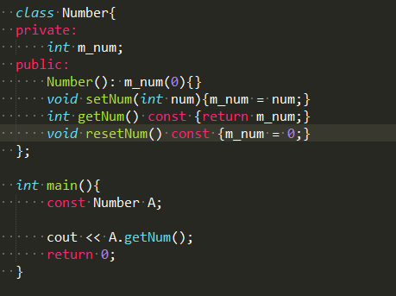
Const member function
Const class objects can only explicitly call const member functions.
A const member function is a member function that guarantees it will not change any class variables or call any non-const member functions.
Notes:
Function resetNum() will cause error since it is a const function and attempts to change a member variable m_num

Slide 28
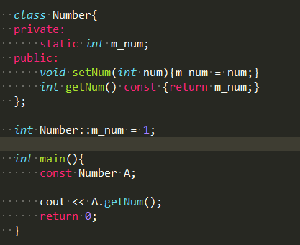
Static member variables
Member variables of a class can be made static by using the static keyword.
static member variables are shared by all objects of the class.
static member variables are created when the program starts, and destroyed when the program ends.
Notes:
Note that this static member definition is not subject to access controls: you can define and initialize the value even if it’s declared as private (or protected) in the class.

Slide 29
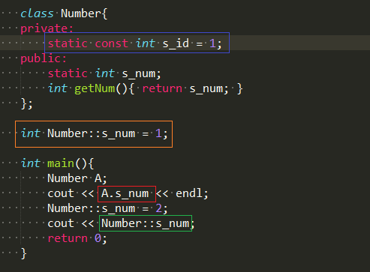
Static member variables
Can be accessed through objects of class(red) or class itself(green).
Must be explicitly defined outside of the class, in the global scope(orange).
Const integer or const enum static member variavles can be initialized directly on the line in which they are declared(blue).

Slide 30
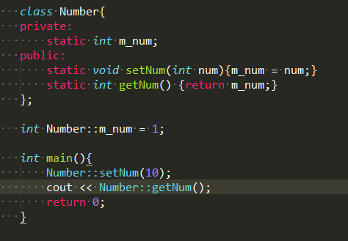
Static member functions
Static member functions are not attached to any particular object.
Static member functions have no *this pointer.
Static member functions can only access static member variables.
C++ does not support static constructors.
Notes:
Static member functions have no *this pointer because static member functions are not attached to an object
They can not access non-static member variables. This is because non-static member variables must belong to a class object, and static member functions have no class object to work with!
If you can initialize normal member variables via a constructor, then by extension it makes sense that you should be able to initialize static member variables via a static constructor. And while some modern languages do support static constructors for precisely this purpose, C++ is unfortunately not one of them.
If your static variable can be directly initialized, no constructor is needed: you can initialize the static member variable at the point of definition (even if it is private).

Slide 31
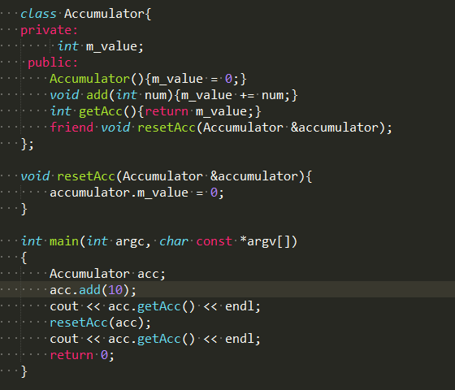
Friend function
Notes:
Function resetAcc can access private member of class Accumulator via keyword friend.

Slide 32
Friend function
Is a function that can access the private members of a class as though it were a member of that class.
may be either a normal function, or a member function of another class.
Is declared using friend keyword in front of the prototype of that function.
Can be declared in either private or public section of the class.
can be a friend of more than one class at the same time.

Slide 33
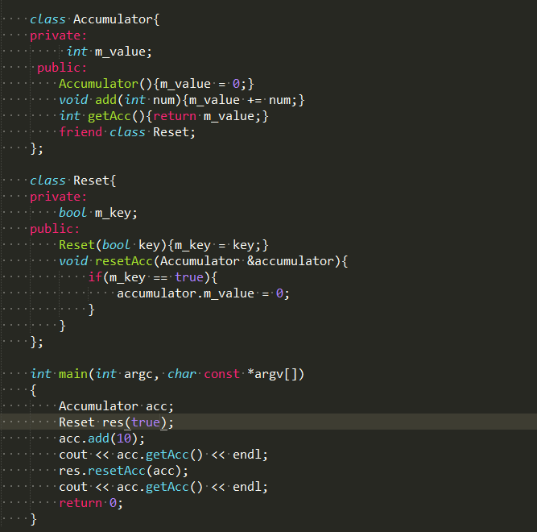
Friend class
Notes:
Class Reset is a friend class of class Accumulator; however, Accumulator is not a friend class of Reset.

Slide 34
Friend class
A is a friend class of B and B is a friend class of C:
All of the members of the A have access to the private members of B.
A has no direct access to *this pointer of B’s objects.
B is not a friend class of A.
A is not a friend class of C.

Slide 35
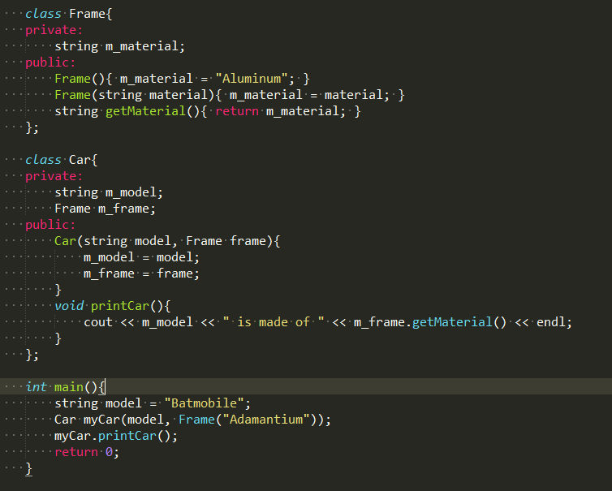
Composition

Slide 36
Composition
What?
process of building complex objects from simpler ones is called composition (also known as object composition).
Why?
Each individual class can be kept relatively simple and straightforward, focused on performing one task.
Each sub object can be self-contained, which makes them reusable.
The complex class can have the simple subclasses do most of the hard work, and instead focus on coordinating the data flow between the subclasses.
Notes:
This makes those classes easier to write and much easier to understand.
3. This helps lower the overall complexity of the complex object, because it can delegate tasks to the sub-objects, who already know how to do them.
Note that:
composition is used for objects that have a has-a relationship to each other.
composition implies ownership between the complex class and any subclasses. When the complex class is created, the subclasses are created. When the complex class is destroyed, the subclasses are similarly destroyed.

Slide 37
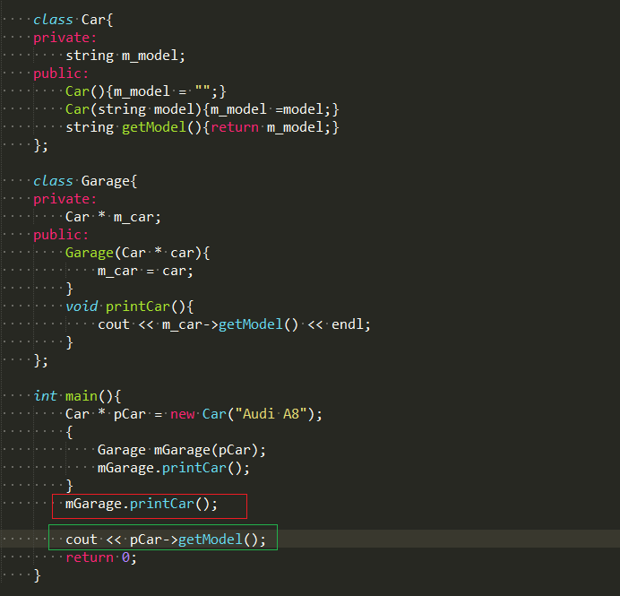
Aggregation
Notes:
The mGarrage.printCar() will cause error since mGarage no longer exists in the scope.
If we remove mGarrage.printCar() the program will run correctly.
pCar is a sub object of mGarage; however, mGarage has no ownership of pCar. pCar can be initialized before mGarage and exist after mGarage is destroyed

Slide 38
Aggregation
Aggregation
Composition
Typically use pointer variables that point to an object that lives outside the scope of the aggregate class.
Can use reference values that point to an object that lives outside the scope of the aggregate class.
Not responsible for creating/destroying subclasses.
Typically use normal member variables .
Can use pointer values if the composition class automatically handles allocation/deallocation.
Responsible for creation/destruction of subclasses .
Notes:
An aggregation is a specific type of composition where no ownership between the complex object and the subobjects is implied.

Slide 39
Container class
What?
A container class is a class designed to hold and organize multiple instances of another class.
Why?
Container class provides the ability to help organize and store items that are put inside it.
Types
Value containers are composition that store copies of the objects that they are holding.
Reference containers are aggregations that store pointers or references to other objects.
Notes:
in C++, containers typically only hold one type of data.
C++ generally does not allow you to mix types inside a container. If you want one container class that holds integers and another that holds doubles, you will have to write two separate containers to do this (or use templates, which is an advanced C++ feature).

Slide 40
Container class
How?
A container class should include functions that:
Create an empty container (via a constructor)
Insert a new object into the container
Remove an object from the container
Report the number of objects currently in the container
Empty the container of all objects
Provide access to the stored objects
Sort the elements (optional)

Slide 41
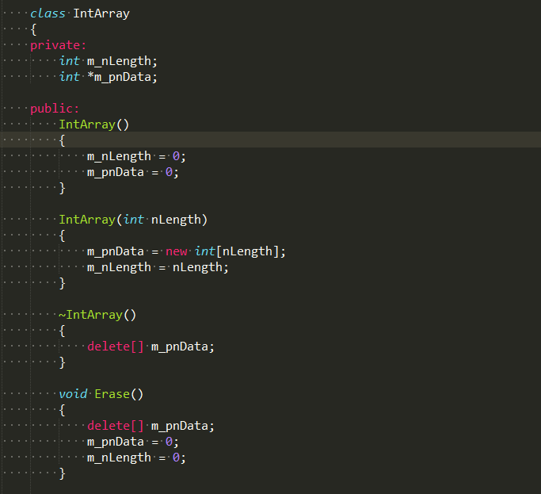
Container class

Slide 42
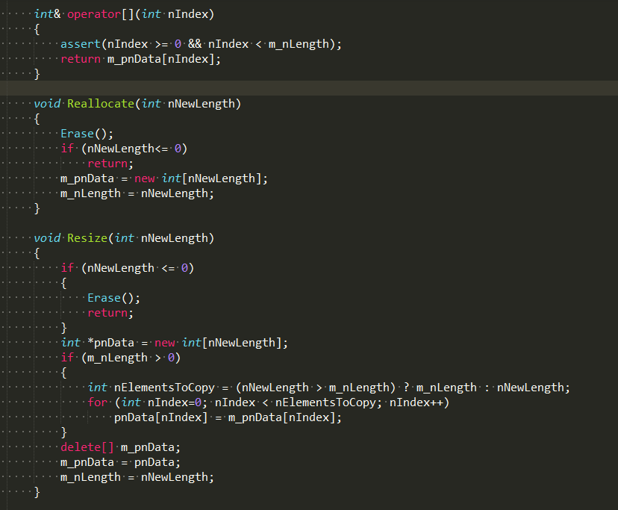
Container class

Slide 43
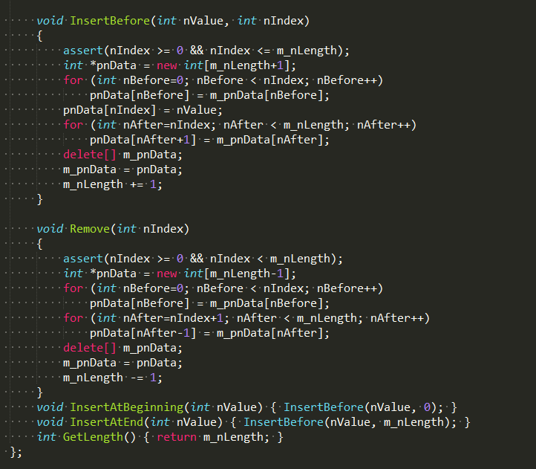
Container class

Slide 44
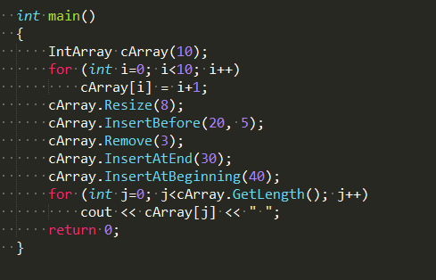
Container class

Slide 45

Thanks for your attention!

